Slide 1
The Field of Social Psychology
Lecture 1
BS-2
Ms. Iqra Naz

Slide 2
Dr. Elaf has a patient Anabia who is a twelve-year-old girl having a severe heart disease. The only solution is heart transplant. Dr. Elaf has another patient Aaira, a fifty-year-old lady in coma. Anabia has been on a ventilator device for almost four years and she has no family because all of her family members died in the same car accident which put her on the ventilator device four years back. Anabia’s heart is the perfect match for the twelve-year-old Aaira.
Should Dr. Elaf remove Anabia from ventilator device and transplant her heart into Aaira, who is in a desperate need? Why or why not?

Slide 3
Values, beliefs and experiences determine what we think we know about others
Sometimes what we think is a fact is just based on our experience
Values change and take shape as we discuss issues with each other
Groups can be difficult to manage as people might have opposing values

Slide 4
What is Social Psychology?
Social Psychology is a science that studies the influences of our situations, with special attention to how we view and affect one another.
Precisely, it is the scientific study of how people think about, influence, and relate to one another.

Slide 5
Compared with sociology, social psychology focuses more on individuals and uses more experimentation
Compared with personality psychology, social psychology focuses less on individuals’ differences and more on how individuals, in general, view and affect one another.

Slide 6
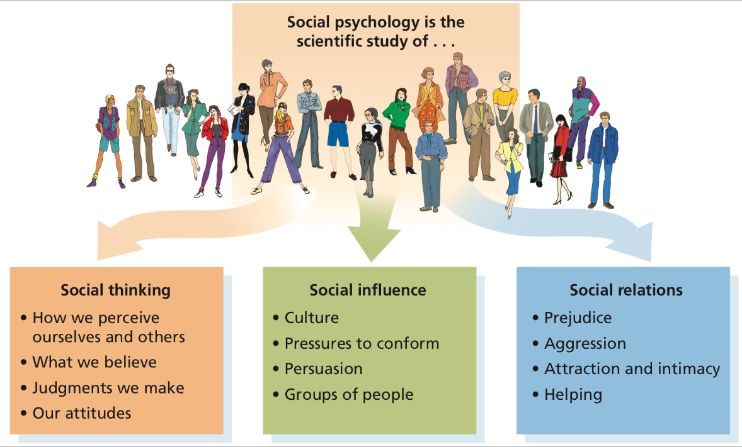

Slide 7
Why do we need to study social behavior?
Different situations activate different parts of the self
Not everyone responds in the same way to the same situation
People change their situations
People choose their situations
Situations change people
Situations choose people
People are inconsistent across situations. People only seem to be consistent because we observe most people in a very narrow range of situations

Slide 8
How Much Of Our Social World Is Just In Our Heads?
Social beliefs can be self-fulfilling. For example, happily married people will attribute their spouse’s acid remark (“Can’t you ever put that where it belongs?”) to something external (“He must have had a frustrating day”). Unhappily married people will attribute the same remark to a mean disposition (“Is he ever hostile!”) and may respond with a counterattack. Moreover, expecting hostility from spouse, they may behave resentfully, thereby eliciting the hostility they expect.

Slide 9
The Social Psychological Approach
Many scholarly fields study social behaviour. What is unique about social psychology is its approach. The social psychological approach differs from disciplines that study large-scale societal processes and from those that focus on the individual.
There are three levels of analysis:
Societal- used by sociologists, economists, political scientists, and other social scientists.
Individual- used by clinical and personality psychologists.
Interpersonal- used by social psychologists.
Social psychologists typically focus on a person’s current social situation. That social situation includes the other people in the environment, their attitudes and behaviors, and their relationship to the individual.

Slide 10
Historical Roots of Social Psychology
Three major theoretical perspectives:
Psychoanalytic theory- Freud’s theory emphasizing unconscious motivation
Behaviorism- Analysis of learning that focuses on observed behavior
Gestalt Psychology- Theory that people form coherent and meaningful perceptions based on the whole, not individual parts

Slide 11
Psychoanalytic Theory
Freud proposed that behaviour is motivated from within by powerful internal drives and impulses, such as sexuality and aggression
He also believed that adult behaviour is shaped by unresolved psychological conflicts that can be traced to childhood experiences in the family.
Psychoanalytic theorists seek to understand the inner forces, both conscious and unconscious, that energize and direct behaviour.

Slide 12
Behaviorism
Focuses on the observable behaviour of humans and other animals
Behaviorists preferred to study what they could observe and measure directly i.e. overt behaviour
They examined ways in which the environment shapes the behaviour of animals, and they proposed that current behaviour is the result of past learning

Slide 13
Gestalt Psychology
Focuses on the way individuals perceive and understand objects, events, and people
In their view, people perceive situations or events not as made up of many discrete elements but rather as dynamic wholes

Slide 14
To sum up…
Psychoanalytic theory analyses motivation and emotion in social life. Behavior is influenced by personal motives and by the emotional reactions individuals have to situations and people.
Behaviorism concerns with how learning shapes social behaviour
Gestalt Psychology emphasises on social cognition, the study of how we perceive and understand our social world.

Slide 15
First experiment in 1897
Perhaps the first social psychology laboratory experiment was undertaken in this area by Norman Triplett in 1897. In his research on the speed records of cyclists, he noticed that racing against each other rather than against the clock alone increased the cyclists' speeds. He attempted to duplicate this under laboratory conditions using children and fishing reels. There were two conditions: the child alone and children in pairs but working alone. Their task was to wind in a given amount of fishing line and Triplett reports that many children worked faster in the presence of a partner doing the same task. Triplett's experiments demonstrate the co-action effect, a phenomenon whereby increased task performance comes about by the mere presence of others doing the same task.

Slide 16
Prominent Figures
Floyd Allport- is considered to be a founder of experimental social psychology, in part for his theoretical rigor and emphasis on measurement
Gordon Allport- younger brother of Floyd Allport, conducted pioneering research on attitudes, prejudice, religion among other topics. In addition to training prominent psychologists such as Stanley Milgram, Thomas Pettigrew, Jerome Bruner, and Anthony Greenwald, he helped establish the field of personality psychology.

Slide 17
Solomon Asch- Conformity Study.
Leon Festinger-Cognitive Dissonance Theory. Need to maintain internal consistency. Beliefs = Behavior. Change our beliefs / thinking to maintain consistency.
Albert Bandura –Social Cognitive Learning Theory.

Slide 18
Theories in Social Psychology
Case:
At 3 am, one morning, a police officer sees a high school dropout, Larry, coming out of the rear door of a liquor store with a bag full of money. The store, like everything else in the neighbourhood, has long been closed for the night. The officer yells at Larry to stop and put his hands up. Larry turns, pulls a pistol from his pocket, and shoots the officer, wounding him in then leg. Larry is later apprehended and ultimately sent to jail.
For this topic, we will refer to Larry to understand the major contemporary theories in social psychology.

Slide 19
Motivational Theories
Learning Theories
Cognitive Theories
Decision-making Theories
Interdependence Theories
Sociocultural Theories

Slide 20
Motivational Theories
Focuses on individual’s own needs or motives
Our needs influence our perceptions, attitudes, and behaviour
Situations can create or arouse needs that, in turn, lead people to engage in behaviors to reduce those needs
Was Larry motivated by need for money? Was it a way to gain status in peer group? Did he shoot out of fear or anger?

Slide 21
Learning Theories
Central idea- person’s current behaviour is determined by prior experience
Person learns certain behaviors and overtime they become habit
Social Learning Theory- Learning is based on reinforcement and modelling (proposed by Albert Bandura)
Three general mechanisms by which learning occurs:
Classical conditioning
Reinforcement
Observational Learning (Modelling)

Slide 22
Cognitive Theories
Emphasizes that a person’s behaviour depends on the way he or she perceives the social situation
Kurt Lewin applied Gestalt ideas- behaviour is affected both by the individual’s personal characteristics and by the social environment he or she perceives
Core idea in cognitive perspective- we tend spontaneously to group and categorize objects
We perceive some things as standing out and some things as simply being in the background (figure-ground relationship)
Cognitive approaches differ from learning approaches in two major ways:
- current perception rather than past learning
- importance of individual’s perception or interpretation than the objective reality

Slide 23
Decision-Making Theories
The theories assume that individuals evaluate the costs and benefits of various actions and pick the best alternatives in a fairly logical, reasoned way.
They choose the alternative that gives them then greatest rewards at the least cost

Slide 24
Interdependence Theories
Shifts the focus of analysis from the behaviour of one individual to the behaviour of two or more individuals who interact with each other
When two people have mutual influence on each other’s thoughts, feelings, or behaviors, they are interdependent.

Slide 25
Sociocultural Theories
How people’s diverse backgrounds influence their thoughts, feelings, and behaviors
Culture- shared beliefs, values, traditions, and behaviour patterns of particular groups
Socialization- process of sharing then culture to the next generation. Acquiring the rules, standards, and values of a group
Social Norms- rules and expectations about how group members should behave- are a building block of culture
Social Role- set of norms that apply to people in a particular position e.g teachers or students

Slide 26
Individualism VS Collectivism
Individualism: belief in the value of personal identity, uniqueness, and freedom (Westernized White cultures)
Collectivism: emphasis on loyalty to the family, adherence to group norms, and harmonious social relations (African, Asian, and Latin Americans and Eastern cultures)
Culture affects all facets of life from our favorite foods to our beliefs about masculinity and femininity.

Slide 27
Research Methods in Social Psychology
NOTE: Content on this sub-topic is taken from Baron and Myers both. Refer to pages 18-30 of Myers’ Social Psychology (10th Edition) for a broader understanding on the topic of Research.

Slide 28
Social Psychology is an empirical science
Systematic methods are used to gather information about life and to test the usefulness of theories
Social psychological research has 4 broad goals:
Description- careful and systematic, to make reliable generalizations
Causal Analysis- cause and effect relationship
Theory building- develop theory to understand the reasons of behaviors
Application- to solve everyday social problems

Slide 29
Selecting Research Participants
Key is to study the people who later are to be generalized
Representative sample
Random sample- each person gets an equal chance of being part of then study

Slide 30
Biases in Research Samples
College students are over-represented because of convenience.
In older research, males are over-represented.
Ethnic minority groups are under-represented.

Slide 31
Correlational VS Experimental Designs
Correlational Research- Testing the association between two or more factors.
When Variable A is high, is Variable B also high (positive correlation) or low (negative), or is B’s value unrelated (no correlation)
Advantages: 1) Enable researchers to study problems in which intervention is impossible
2) Is efficient. Allow researchers to collect more information and test more relationships than they can in most experiments

Slide 32
Limitations:
Does not provide clear-cut evidence of cause-and-effect relationships. Ambiguous in two ways:
1) Reverse-Causality Problem: the direction of causality is unknown: Does A cause B, or vice versa?
2) Third-Variable Problem: if two variables are correlated, is one the cause of the other? Or is some third variable the cause of both?

Slide 33
Experimental Research- Research that randomly assigns people to conditions, varies treatment in each condition, and measures effect on responses.
Independent Variable- Factor that is manipulated by the experimenter
Dependent Variable- The response to the IV being manipulated
Operational Definition- Specific procedure used to measure or manipulated a variable
Random Assignment- Guaranteeing the subject are placed in experimental conditions on the basis of chance

Slide 34
Field VS Laboratory Settings
Field research examines behavior in its natural habitat
Laboratory research is conducted in an artificial situation.
Advantages of Lab Experiment:
Highly controlled
High internal validity
More convenient
Less costly

Slide 35
Advantages of Field Research:
More realistic.
Results more generalizable to a wider population
High external validity
Allows researcher to study powerful situations
Minimizes suspicion by participants
Refer to table 1-2 for a clear comparison

Slide 36
Methods of Data Collection
1) Self-Report:
- Most common technique of data collection
Advantage: Measures subjective states such as perceptions, emotions and attitudes
Disadvantage: Reliance on people to give honest descriptions of own internal feelings

Slide 37
2) Observational Research:
Direct observation is a widely used research technique
Overt- participants knows who the researcher is and they know that they are being observed.
Covert- participants do not know that a researcher is in the group observing them.
Participant- researchers become a part of the group they wish to observe. Researchers can be overt or covert about this.
Non-participant- researchers are “away” from the people or animals they are observing. This can also be overt or covert.
Advantage- High ecological validity
Disadvantage- Problem of demand characteristics, reduces validity of findings

Slide 38
3) Archival Research:
Analysis of existing data used for another purpose
Advantages- i) Inexpensive ii) Allows researcher to test hypotheses about changes in attitudes or behaviour over time be limited to one historical moment
Disadvantage- Difference in previous and current hypothesis, participants, questions etc.

Slide 39
4) Internet Research:
Advantages: i) Easier to recruit participants from diverse backgrounds, geographical regions, or specialized groups
ii) Information is automatically recorded. This increases efficiency
iii) Much less expensive
iv) Internet chat rooms and Facebook groups provide rich sample of human social behaviour where people discuss current issues
Disadvantages: i) Biased or fake sample
ii) Uncontrolled set up and environment

Slide 40
Bias in Research
Two troublesome biases in social psychology research are:
Experimenter bias: unintentional acts by the researcher can bias results
Subject bias/demand characteristics: aspects of research that make people aware that they are being studied can bias their behavior.

Slide 41
Research Ethics
Informed Consent
Debriefing
Minimal Risk
Confidentiality
Deception
Mundane Realism (describes the degree to which the materials and procedures involved in an experiment are similar to events that occur in real world).
Experimental Realism ( is the extent to which situations created in social psychology experiments are real and impactful to participants)

Slide 42
GROUP ACTIVITY

Slide 43
Research Topics
Relationship between self-esteem and test performance
Relationship between amount of time couples spend together and their relationship satisfaction
Relationship between time spent listening to Heavy Metal music and aggression

Slide 44
Questions
Design a correlational study;
What is your hypothesis?
How will you measure the two variables?
How will you obtain a random sample of participants?
Design an experimental study;
What is your hypothesis?
What is your IV and DV?
Will you use random assignment to conditions?
Do any ethical concerns about the treatment of participants emerge from your experimental design?

Slide 45
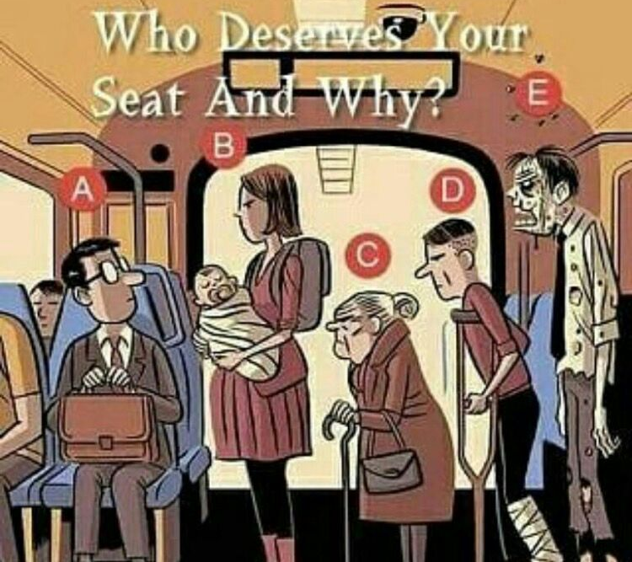

Slide 46


